Slide 1
Analysis on REITs

Slide 2
What is REITs
A real estate investment trust (REIT) is a company that owns, operates, or finances income-generating real estate. They package properties they owned as mutual trusts and put into equity market.
The function of REITs is similar to stock. They pool the capital of numerous investors. This makes it possible for individual investors to earn dividends from real estate investments without having to buy, manage, or finance any properties themselves. Compared with physical real estate investments, REITs is more accessible and liquid.
Moreover, REITs invest in most real estate property types, including apartment buildings, data centers, hotels, medical facilities, offices, retail centers, and warehouses etc. In other words, REITs is flexible in invest in commercial, public and residential property at same period. In contrast, the physical real estate investments may not achieve this diversification.
## S-REITs
Singapore REITs are an important component of Singapore’s stock market
Largest REIT market in Asia ex-Japan. Specially, one-fifth the stock market of SG is taken by REITs.
Source: <https://www.reitas.sg/singapore-reits/overview-of-the-s-reit-industry/>

Slide 3
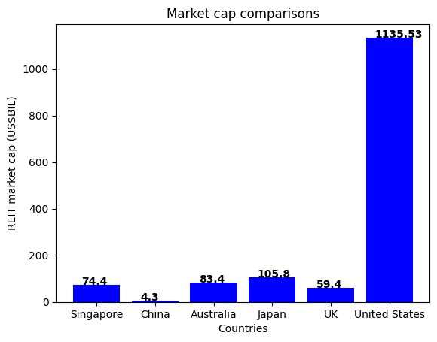
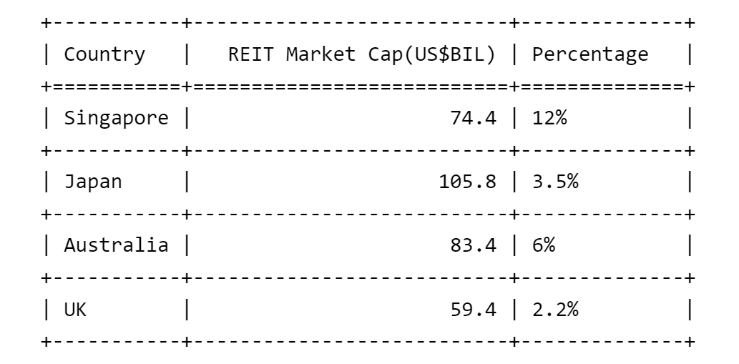
The market cap of S-REITs is comparable to Australia and UK. In percentage of the entire stock market, S-REITs shows a large impacts.

Slide 4
What is REITs
## characterizes of REITs
### High dividends but low value
By law and IRS regulation, REITs must pay out 90% or more of their taxable profits to shareholders in the form of dividends. As a result, REIT companies are often exempt from most corporate income tax. Hence, REITs provide a high dividend for investors.
*Forward dividend & yield*
The percentage of a company's current stock price that it expects to pay out as dividends over 12 months. (Based on 15th March close price calculation)

Slide 5
What is REITs
REITs:
Sabana REIT (SGX: M1GU)
An industrial REIT with a portfolio of 18 properties in Singapore covering high-tech industrial, warehouse and logistics, and general industrial sectors.
Keppel Pacific Oak US REIT (SGX: CMOU)
An office REIT with 13 freehold office buildings and business campuses across eight markets in the US.
Frasers Logistics & Commercial Trust (SGX: BUOU)
A diversified portfolio of 108 properties across Singapore, the UK, Australia, the netherlands and Germany.
Mapletree Logistics Trust (SGX: M44U)
An industrial REIT with a portfolio of 187 properties spread across eight countries. The price of these REITs in over one years.
Stocks in other sectors (Non-REITs):
SGX-Singapore Exchange Limited,
Telecommunications - Singapore Telecommunications Limited,
Industrial Goods and shipbuilding - Yangzijiang Shipbuilding (Holdings) Ltd.
Food & Beverage- Wilmar International Limited (5%) Agriculture Golden Agri-Resources Ltd
Transportation-Singapore Airlines Limited
Utilities-Sembcorp Industries Ltd
Services-United Overseas Insurance Limited
Real-estate Stocks:
Keppel Ltd.
CapitaLand Investment Limited
City Developments Limited

Slide 6
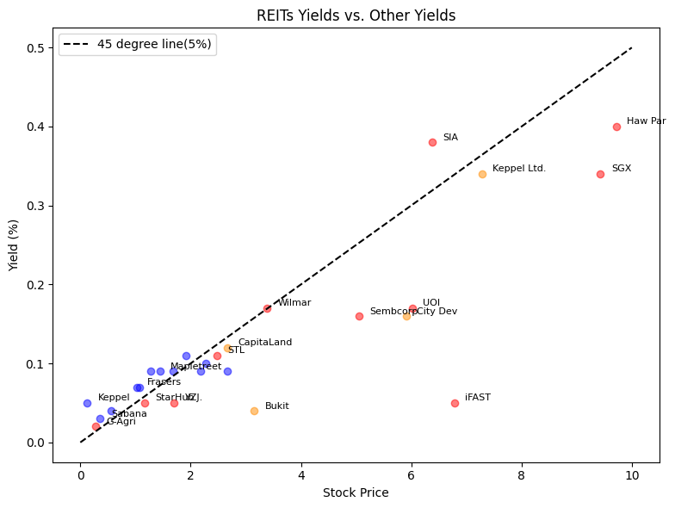
What is REITs

Slide 7
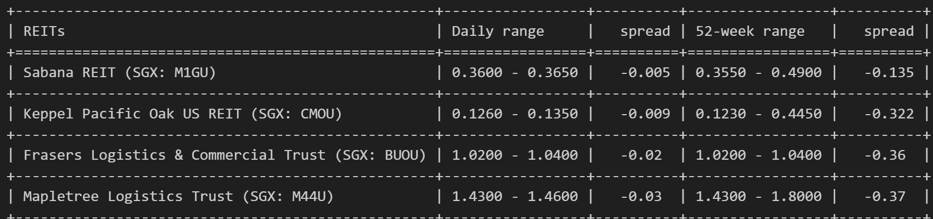
What is REITs
The forward dividends & yields of REITs is relative high. However, the price of REITs less than other stocks.
Why ?
The contractual nature of commercial real estate leases and the predictability of rental income and expenses give REITs a defensive quality - the price is relative stable at certain level.
### stability
The character of REITs allowing analysts to more accurately forecast earnings, which helps reduce share price volatility.

Slide 8
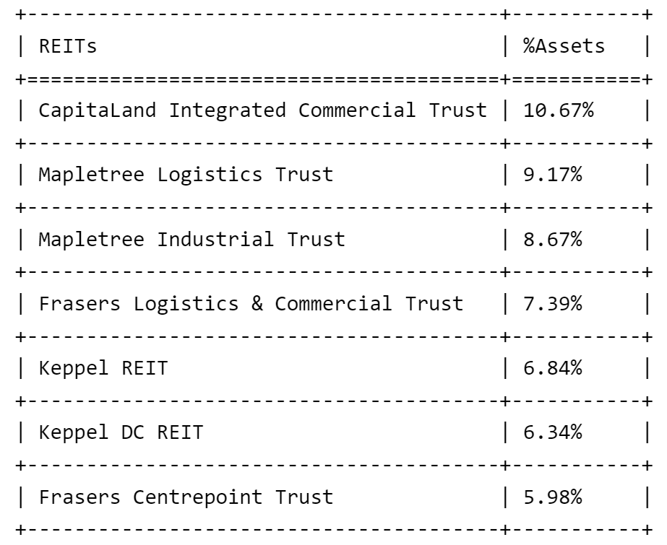
What is REITs
### Exposure to global real estate
Over 90% of S-REITS own properties outside Singapore. Digging deeper in the systematic risk these REITs face.
For analysis, in this section, we use CSOP iEdge S-REIT Leaders Index ETF (SRU.SI) as a proxy for SREITs and SG real estate market.
Top 7 Holdings of CSOP iEdge S-REIT Leaders Index ETF (55.04% of Total Assets)

Slide 9
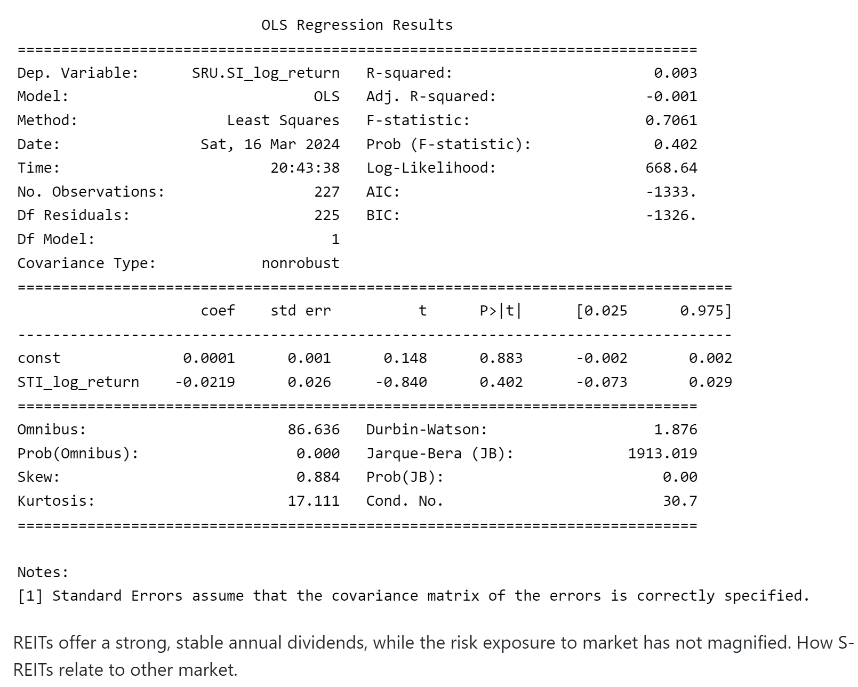
What is REITs

Slide 10
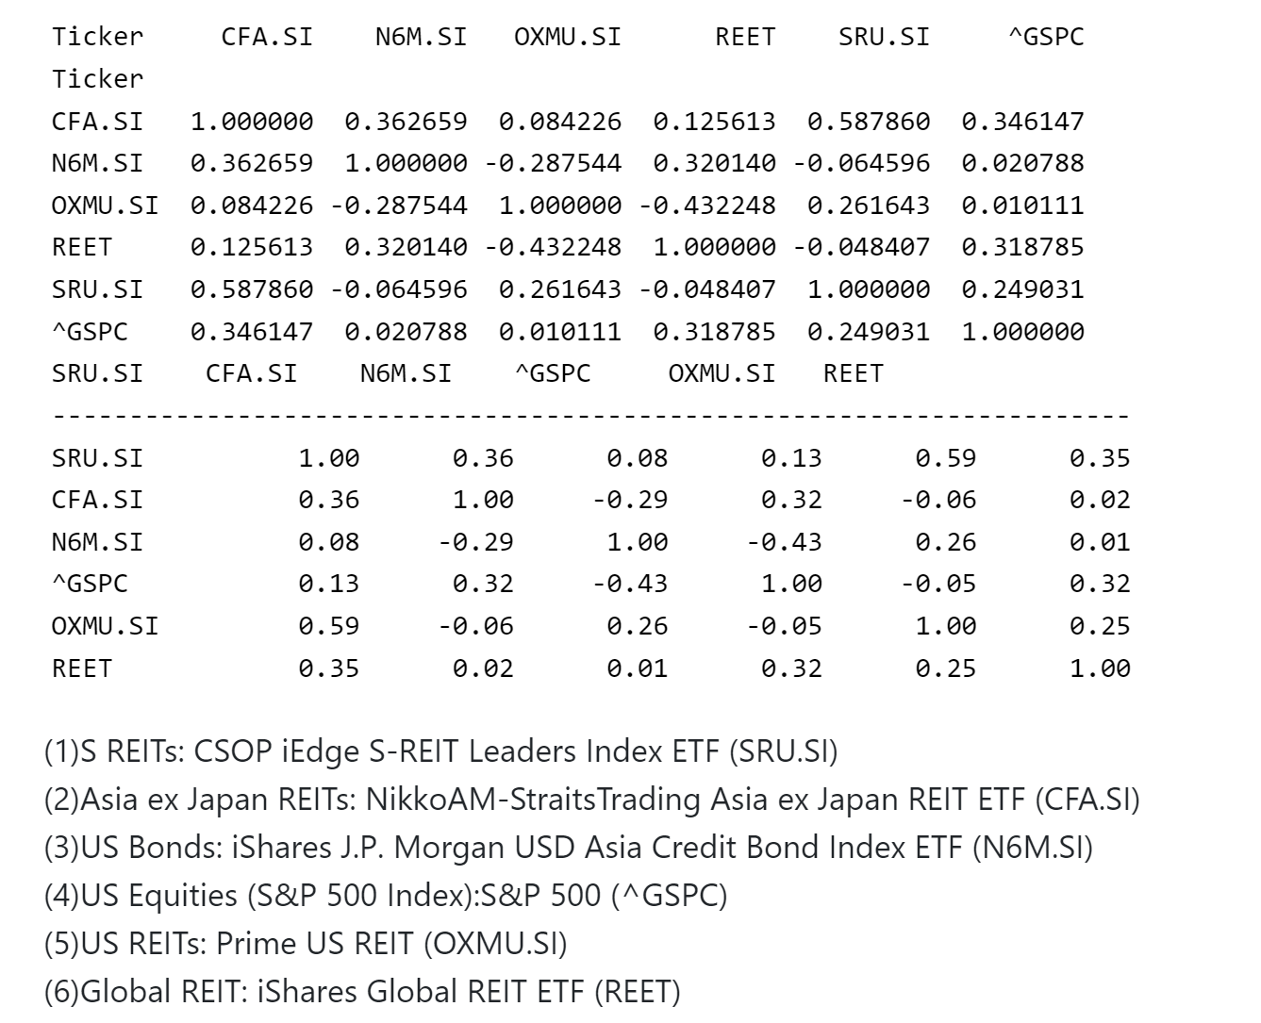
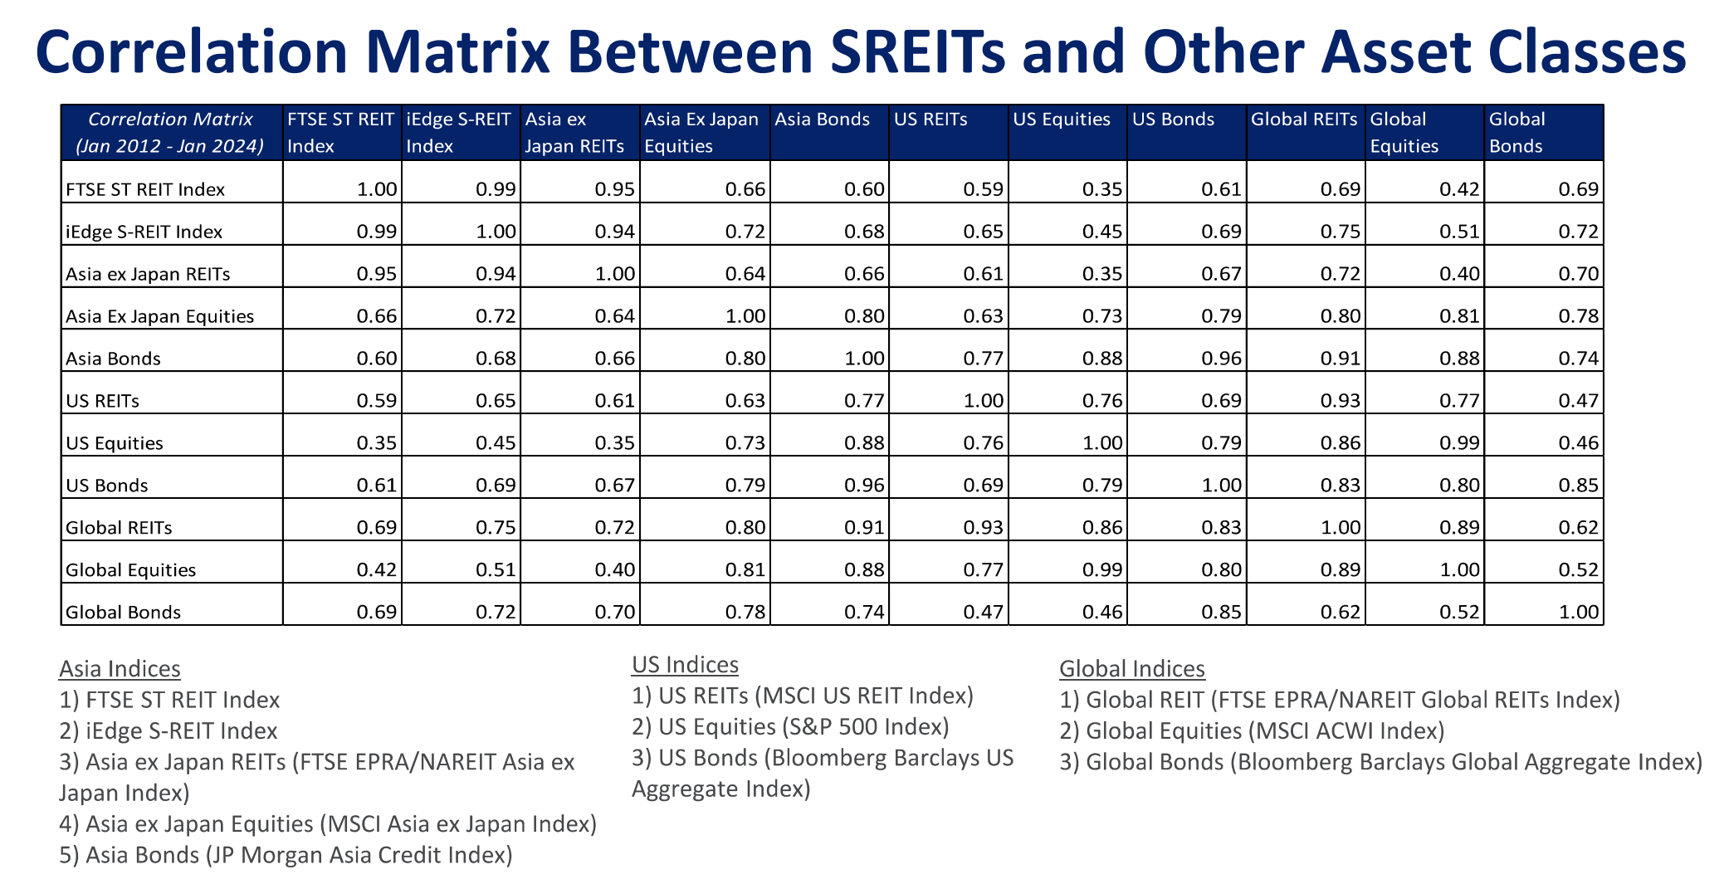
What is REITs

Slide 11
What is REITs
### diversification
REITs provide diversification benefits.
1. Generate following portfolios:
(1) 55% Market index funds + 35% Bonds + 10% REITs
(2) 40% Market index funds + 40% Bonds + 20% REITs
(3) 33.3% Market index funds + 33.3% Bonds + 33.3% REITs
(4) 60% Market index funds + 40% Bonds
(5) 80% Market index funds + 20% Bonds
Market index: S&P 500 (^GSPC)
Bonds: iShares 0-5 Year TIPS Bond ETF (STIP)
REITs: CSOP iEdge S-REIT Leaders Index ETF (SRU.SI)

